Slide 1



OFFICIAL TECHNICAL SCOPE OF WORK (SOW) & PROJECT ROADMAP
Rajgir Marathon — Digital Platform Scope of Work
"Run Through History"
Comprehensive Web Portal, Mobile Application (iOS & Android) & Event Operations Ecosystem
Prepared For Rajgir Marathon Executive Committee
Target Timeline 3.5 Months (14-Week Execution Plan)

Slide 2








Strategic Vision & Key Project Objectives Rajgir Marathon
1. World-Class Digital Journey
2. Sports Tourism & Heritage Synergy
3. Multi-Stakeholder Ecosystem
■
Frictionless runner onboarding across Web and Mobile Apps.
■
Spotlight Rajgir's iconic landmarks (Vishwa Shanti Stupa, Glass Floor Bridge, Nature Safari).
■
Specialized digital portals tailored for Corporate Teams.
■
Instant multi-tier payments via Razorpay integration.
■
Dedicated Sponsor dashboard and inventory management.
Automated digital bib issuance and security.
■
Dedicated Tourism portal featuring hotel directories.
Volunteer shift allocation and credential systems.
■
■
Live runner tracking and instant e-certificates.
■
Curated local experiences and travel itineraries.
Media Personnel and Administrator control centers.
■
■

Slide 3



Technical Audit & Codebase Readiness Summary
System Component | Inherited Status | Audit Finding & Upgrade Plan
Architecture Base | React 18, Node.js | Base JWT auth & Razorpay link exist (~28% ready). Upgrade required.
Brand Identity | Hardcoded Old | Vadodara Marathon hardcoded. Complete rebrand to Rajgir Marathon across UI, APIs & Emails.
Infrastructure | Local Ephemeral | Migrate file uploads (`/uploads`) to high-availability AWS S3 Cloud Storage.
Security & Safety | Simulated OTP | Phone OTP simulated, no rate limit. Integrate MSG91 real SMS OTP, rate limiting & helmet.js.
28%
INHERITED READINESS SCORE

Slide 4





Comprehensive Web Portal Architecture Public Experience
Dynamic Homepage
9 Race Categories
Live event countdown timer, hero banner carousel, race categories grid, sponsor slider, and testimonials.
Dedicated pages for 42K, 21K, 10K, 5K, Kids, Senior Citizens, Corporate, Defence, and Virtual Run.
Rajgir Tourism Guide
Media & Press Center
Interactive directory for Hotels, Resorts, Glass Bridge, Nature Safari, Ropeway, Restaurants, and Itineraries.
Press releases, downloadable media kit, media press accreditation form, video gallery, and live stream.

Slide 5











Multi-Tier Registration & Payment Checkout Workflow
End-to-End Registration Engine: Engineered for both individual athletes and large institutional delegations. Supports GST tax invoices, medical clearance, t-shirt size sizing, and instant digital bib generation.
Registration Type Select
Medical & Waiver
Merchandise Selection
Individual, Group/Family, Corporate (GST compliant), School/College, International.
Mandatory health declaration, emergency contacts, blood group, digital waiver signature.
T-shirt size selection, optional merchandise upgrades and add-ons.
Razorpay Checkout
Tax Invoice Generation
Digital BIB & QR
Multi-payment support (UPI, Credit/Debit Cards, NetBanking, Wallets).
Instant downloadable GST-compliant PDF invoice sent via email.
Automated sequential BIB allocation and QR code generation for Expo check-in.

Slide 6



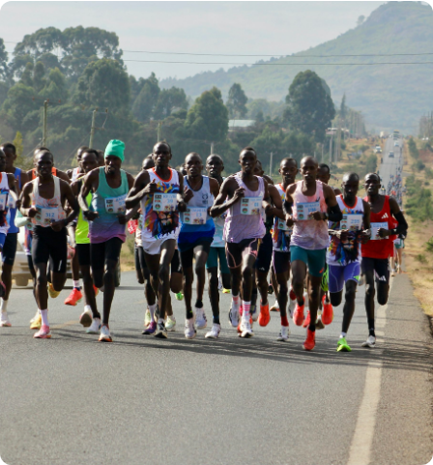

Personalized Runner Dashboard Experience
Active Race Overview & Digital BIB
Upcoming event countdown, profile management, and a mobile-friendly digital bib displaying QR code for rapid Expo check-in validation.
Payment & Invoice Records
Access complete billing transaction history with one-click GST tax invoice PDF downloads.
Timing & Performance Center
Real-time display of chip time, gun time, overall rank, gender rank, and category rank.

Slide 7





Interactive Route Map & Race-Day Station Markers
Google Maps API Integration
High-resolution vector overlays for 42K, 21K, 10K, and 5K courses. Includes a dynamic interactive elevation graph showing the terrain profile and hill challenges across the route.
Interactive Station Markers
💧 Hydration & Water Stations
🚑 Medical Tents & First Aid
🚻 Washrooms & Facilities
🍎 Refreshment Zones
🅿️ Parking & Drop-offs
📸 Photography Points

Slide 8

Dedicated Ecosystem Stakeholder Portals
Volunteer Management Portal
Sponsor & Brand Portal
Corporate Dashboard
■
Corporate registration & sponsorship tier selection (Title, Gold, Silver).
■
Corporate coordinator master login.
■
Self-registration form & role preferences (Expo, Route Marshal, Medical).
■
Bulk employee CSV import & auto-verification.
■
Branding inventory selector (Start Arch, Bibs, Medals, LED).
■
Admin duty allocation & shift schedule management.
■
Corporate team challenge leaderboard.
■
GST-compliant billing & high-res artwork upload.
■
Venue check-in attendance tracking.
■
ESG & CSR participation reporting metrics.
■
Automated digital volunteer e-certificates.

Slide 9




Training Module & Runner Community Platform
Interactive Training & Health Tools
Community & Co-Runner Discovery
■
Interactive Pace Calculator: Input target finish time to calculate exactly required KM split pacing strategies.
■
Co-Runner Match Engine: Search registered runners by City, Age Group, Target Pace & Gender to build local training groups.
■
BMI & Hydration Estimator: Personalized health metrics and race-day fluid intake recommendations.
■
Running Club Directory: Index of city clubs, corporate teams, and women's running groups.
■
Race Prep Guides: Expert articles on marathon training plans, taper strategies, nutrition, stretching, and injury prevention.
■
Discussion Boards: Moderated forums for travel advice, carpooling, and accommodation sharing.

Slide 10


Race-Day Live Results & Timing Engine
WORKFLOW 1
WORKFLOW 2
WORKFLOW 3
WORKFLOW 4
RFID Data Ingestion (REST API & CSV)
Real-Time Leaderboard Publishing
Automated Category & Gender Ranking
Instant Certificate & Social Share
Rank | Runner Name | BIB | Category | Net Chip Time | Pace (Min/KM) | Status
#1 | Rajesh Kumar | 42102 | Full Marathon (42K) | 02:34:12 | 3:39 min/km | Finisher
#2 | Ananya Sharma | 21045 | Half Marathon (21K) | 01:18:45 | 3:44 min/km | Finisher
#3 | Vikram Singh | 10088 | 10K Challenge | 00:32:10 | 3:13 min/km | Finisher

Slide 11

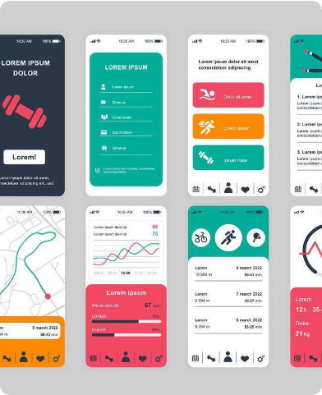




Integrated React Native Mobile Application
Offline Digital BIB
Push Alerts (Firebase)
Displays digital bib and QR code offline for seamless Expo check-in without network connectivity.
Real-time updates for race start schedules, weather warnings, emergency alerts & live results.
GPS Live Locator
Emergency SOS
GPS-enabled mobile map displaying runner position relative to nearest medical tent & water station.
One-tap panic trigger transmitting instant live GPS coordinates to race medical command.

Slide 12








AI-Powered Runner Intelligence Platform
AI Running Coach
AI Nutrition Advisor
AI Assistance Modules
Personalized marathon training plans based on runner experience, race category, historical performance, and target finish time.
Daily nutrition recommendations, hydration schedules, calorie estimation, and optimized race-week meal planning.
AI Event Assistant: 24×7 intelligent chatbot for race day FAQs.
AI Co-Runner Recommendation: Matches peers with similar pace metrics.
AI Injury Prevention
AI Race Predictor
AI Sponsor Recommendation: Suggests brand offers based on runner profile.
Training load analysis paired with recovery recommendations and active injury risk alerts using running history.
Predict finish time, pace strategy, and milestone estimates using historical performance and training progress models.
AI Customer Support Chatbot: Automated issue resolution and ticketing.

Slide 13










Advanced Runner Community & Social Ecosystem
Find Co-Runner
Team Collaboration
Running Communities
■
Search network by City and Age Group.
■
Invite friends and Create new Teams.
■
City, Women's, College & Corporate Clubs.
■
Filter by Target Pace & Gender.
■
Join existing Teams or Squads.
■
Trail Running specialized communities.
■
Discover peers by Company.
■
Dedicated encrypted Team Chat.
■
Discover Weekend Running Events.
■
Match based on specific Running Interests.
■
Group Announcements & Training Groups.
■
Community Discussions & Leaderboards.

Slide 14





Memories, Media & Digital Achievement Platform
Personal Race Memories
■
Dashboard Includes: Official Race Photos & Videos.
■
Analytics: GPS Route Replay mapping their exact run.
■
Achievements: Digital Medal Collection & Finisher Certificate.
■
Sharing: Personal Race Story & 1-click Social Media Sharing.
Event Gallery & Media
■
Coverage: Official Event Photography & Drone Coverage.
■
Access: Race Highlights library and high-res Media Downloads.
■
Smart Search: AI-powered photo search using runner BIB Number.

Slide 15







Advanced Administration & Vendor Operations
Vendor Management Portal
Advanced Admin Dashboard
Complete administration console including:
Digital onboarding and management for:
■
Event Management
■
Communication Center
Food & Beverage Vendors
■
User & Registration Mgmt
■
Results & Timing Mgmt
■
Merchandise & Apparel Vendors
■
Payment & Refund Mgmt
■
Finance Reports
■
■
Volunteer Management
■
Analytics Dashboard
■
Medical & First Aid Vendors
■
Sponsor Management
■
Content Management (CMS)
■
Logistics & Transport Partners
■
Vendor Management
■
Security & Audit Logs
■
Expo Booth Operators

Slide 16








Smart Health & Wearable Integrations
Fitness Ecosystem Integrations
Smart Health Features
Communication Integrations
■
Automatic Activity Sync
■
Apple Health & Google Fit
Training Progress Tracking
■
WhatsApp & SMS Gateway
■
■
Garmin Connect & Strava
Heart Rate & Distance Analytics
■
Email Notifications
■
■
Fitbit & Coros
■
QR Scanner System
■
Suunto API support
■
Recovery Monitoring & Dashboards
■
RFID Timing Hardware Integration

Slide 17



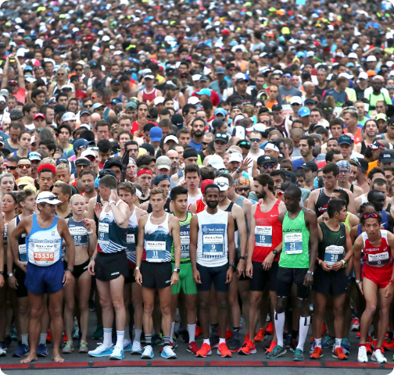

Event Schedule & Future Expansion Roadmap
Digital Event Schedule
Interactive event calendar application module tracking:
■
Marathon Expo
■
Race Start Timeline
■
Bib Collection
■
Prize Distribution
■
Press Conference
■
Closing Ceremony
■
Opening Ceremony
Platform Expansion Vision
Designed as a scalable architecture supporting:
■
Multiple Marathon Events
■
Cloud-native Infrastructure
■
Multi-language Support
■
API-first Architecture
■
State & National Series
■
High Availability Deployment
■
AI-powered Personalization

Slide 18

3.5-Month (14-Week) Execution Roadmap
Phase | Duration | Focus Areas (Web & Mobile Platform)
Phase 1 | Weeks 1 – 4 | Rebranding to Rajgir, AWS S3 storage setup, Security hardening, Public Web Portal, Tourism section, Route Maps.
Phase 2 | Weeks 5 – 8 | Multi-tier Registration, Razorpay integration, Digital BIB engine, Tax Invoices, Runner Dashboard, Mobile Auth.
Phase 3 | Weeks 9 – 11 | Volunteer Portal, Sponsor Inventory Portal, Corporate Dashboard, Training Calculators, Mobile Map & Push.
Phase 4 | Weeks 12 – 14 | Live Results Engine, RFID Data Ingestion, PDF Certificate Engine, Security Audit, Store Publishing, Go-Live.

Slide 19

Third-Party Infrastructure & Operational Budgeting
Service Module | Provider | Purpose / Billing Model | Approx. Cost (INR ₹)
Cloud Hosting & CDN | DigitalOcean / AWS | Server & DB hosting (Monthly) | ₹4,000 – ₹8,000 / mo
Cloud Media Storage | AWS S3 | Asset & image storage (Monthly) | ₹1,500 – ₹3,500 / mo
SMS Gateway API | MSG91 / Twilio | Phone OTP & SMS alerts (One-time) | ₹3,000 – ₹7,000 total
WhatsApp Business | Interakt / Gupshup | Automated notification alerts | ₹4,000 – ₹10,000 total
Payment Gateway | Razorpay | Online checkout processing | 2% + GST per txn
App Store Accounts | Apple & Google | Publisher accounts (One-time/yr) | ₹9,600 total

Slide 20

Project Deliverables & Rollout Plan
Tangible Project Deliverables
Immediate Next Steps
■
Production Web Portal: Live deployment on `rajgirmarathon.com`.
■
1. Scope of Work Formal Sign-off: Approve execution of SOW.
■
Native Mobile Apps: Published iOS & Android apps on Apple App Store & Google Play.
■
2. Third-Party Credentials Setup: AWS, Razorpay, MSG91, Apple/Google Accounts.
■
Admin Control Center: Complete back-office management console for organizers.
■
3. Phase 1 Execution Kickoff: Initiate brand identity update & AWS infrastructure stabilization.
■
Source Code Repositories: Fully documented Git repositories & Swagger API docs.

